Slide 1
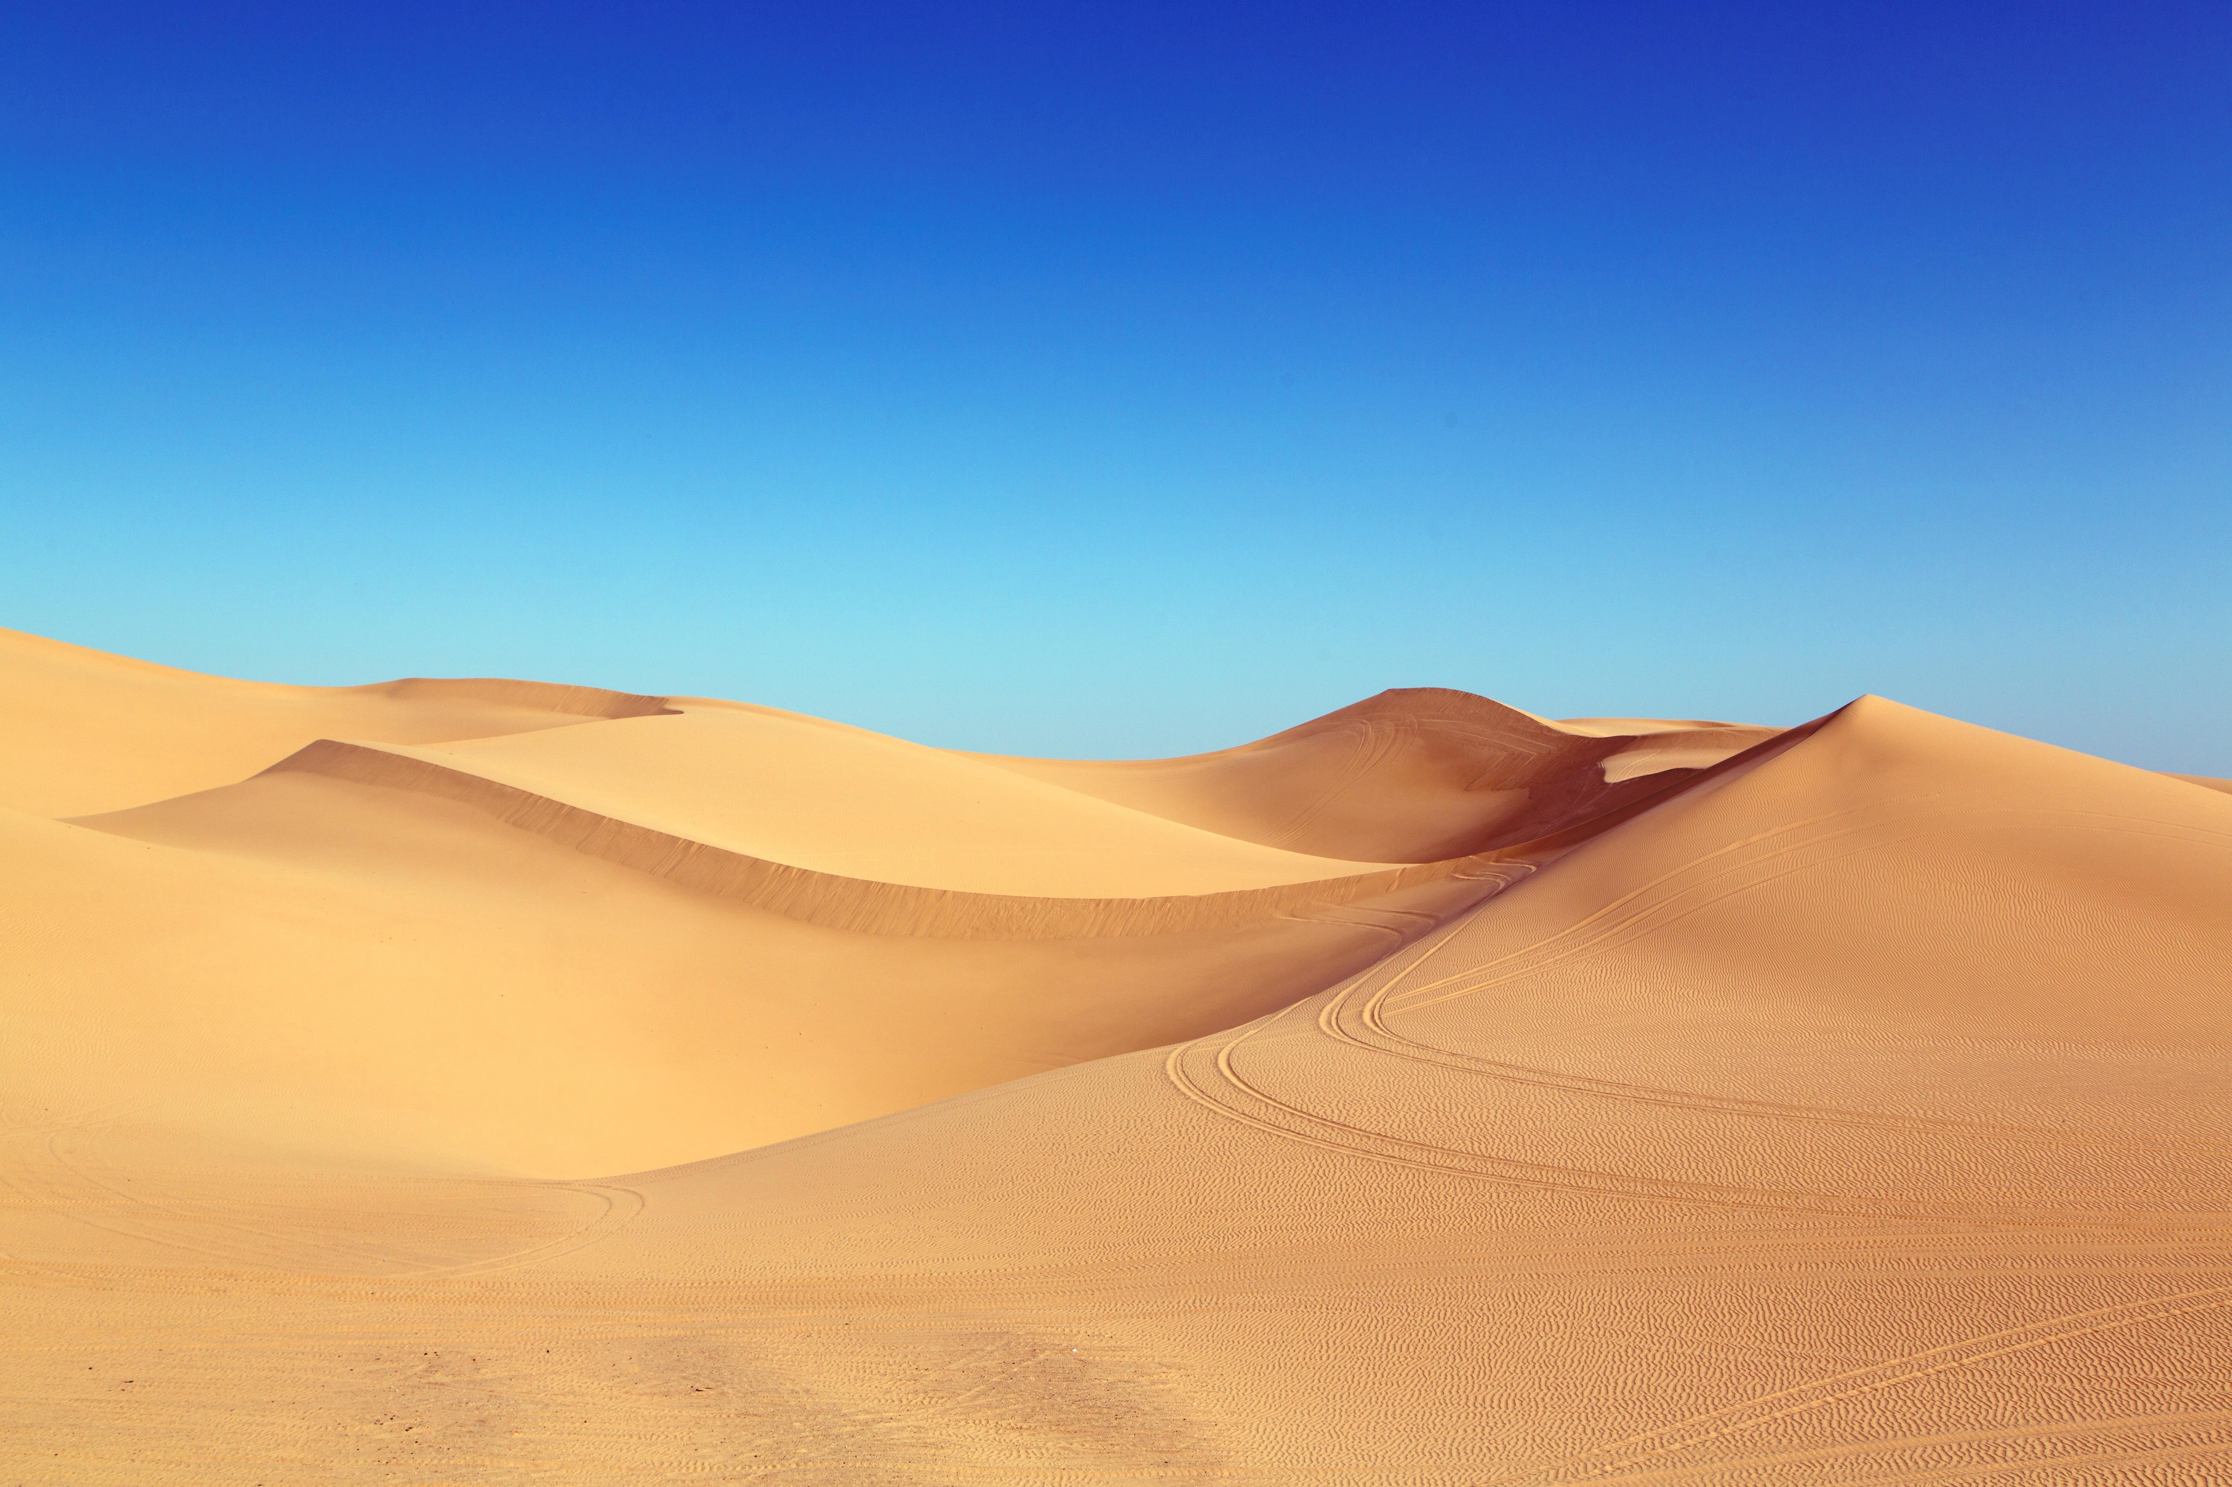
Tour Explorer
Group Members
Muhammad Hamza Aziz (FA19-BSE-001)
Ahmad Mujtaba(FA19-BSE-113)
Supervisor
Dr. Shahbaz Akhtar Abid

Slide 2
Project Motivation
Tourism is a significant factor in economic Growth. As tourism became the world’s largest industry by growing rapidly in the last two decades.
No Platform for guided tours and attractions recommendation in Pakistan

Slide 3
Objectives
The objectives of our project are:
• Το Χreate a unique platform for tourists and recommend them major attractive spots.
• To provide an opportunity for locals to register to our web app and sell their services as a Tour Guide.
• To provide a Guided Tour booking system

Slide 4
Features
01
View Top Attraction Sites
Get Top Attractions
View Tour Guides
Book Guided Tours
Online Payment
Real Time Chat
Google Maps Service
User-friendly interface
02
Book Guided Tours
03
Online Payment, Chat and much more

Slide 5
Users
01
Tour Guide
Tourists
Register
Login
View Attractions
Book Tours
Chat
Manage Profile
Tour Guide
Register
Login
CRUD Packages
Get Reservations
Chat
Manage Profile
02
Tourist
Admin
Login
Manage Profile
View Reservations
Manage Users
Manage Packages
03
Admin

Slide 6
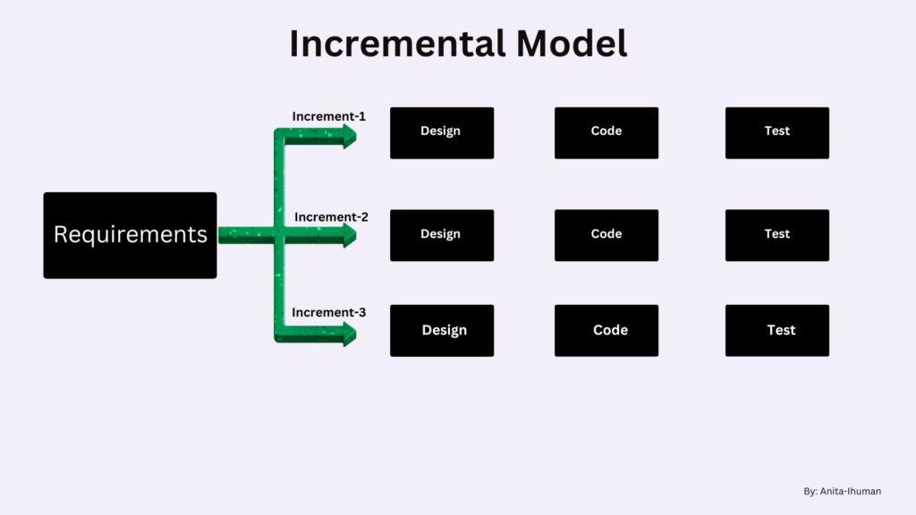
Model Used
We are using Incremental Process Model for our project.

Slide 7
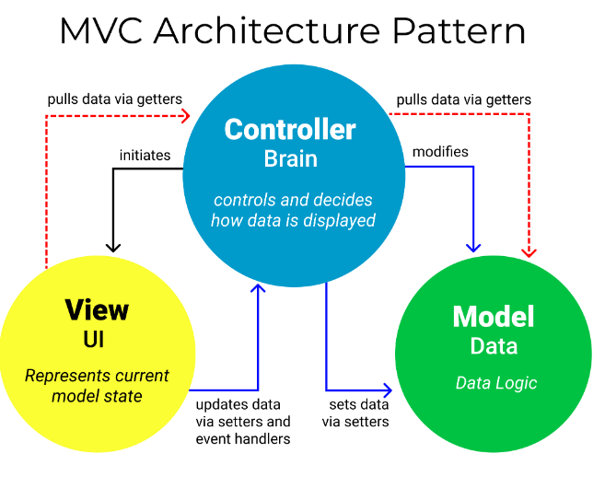
Software Architecture

Slide 8






Technologies Used

Slide 9
UseCase Diagrams

Slide 10
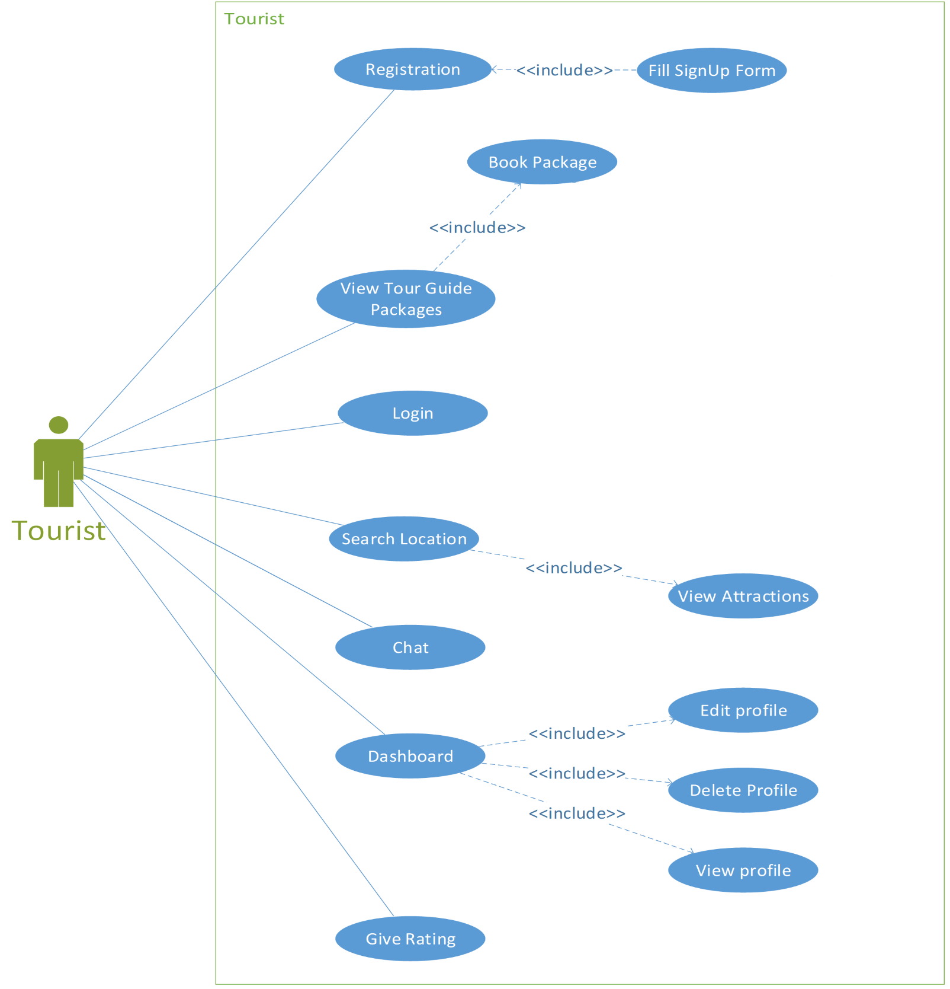
Tourist Usecases

Slide 11
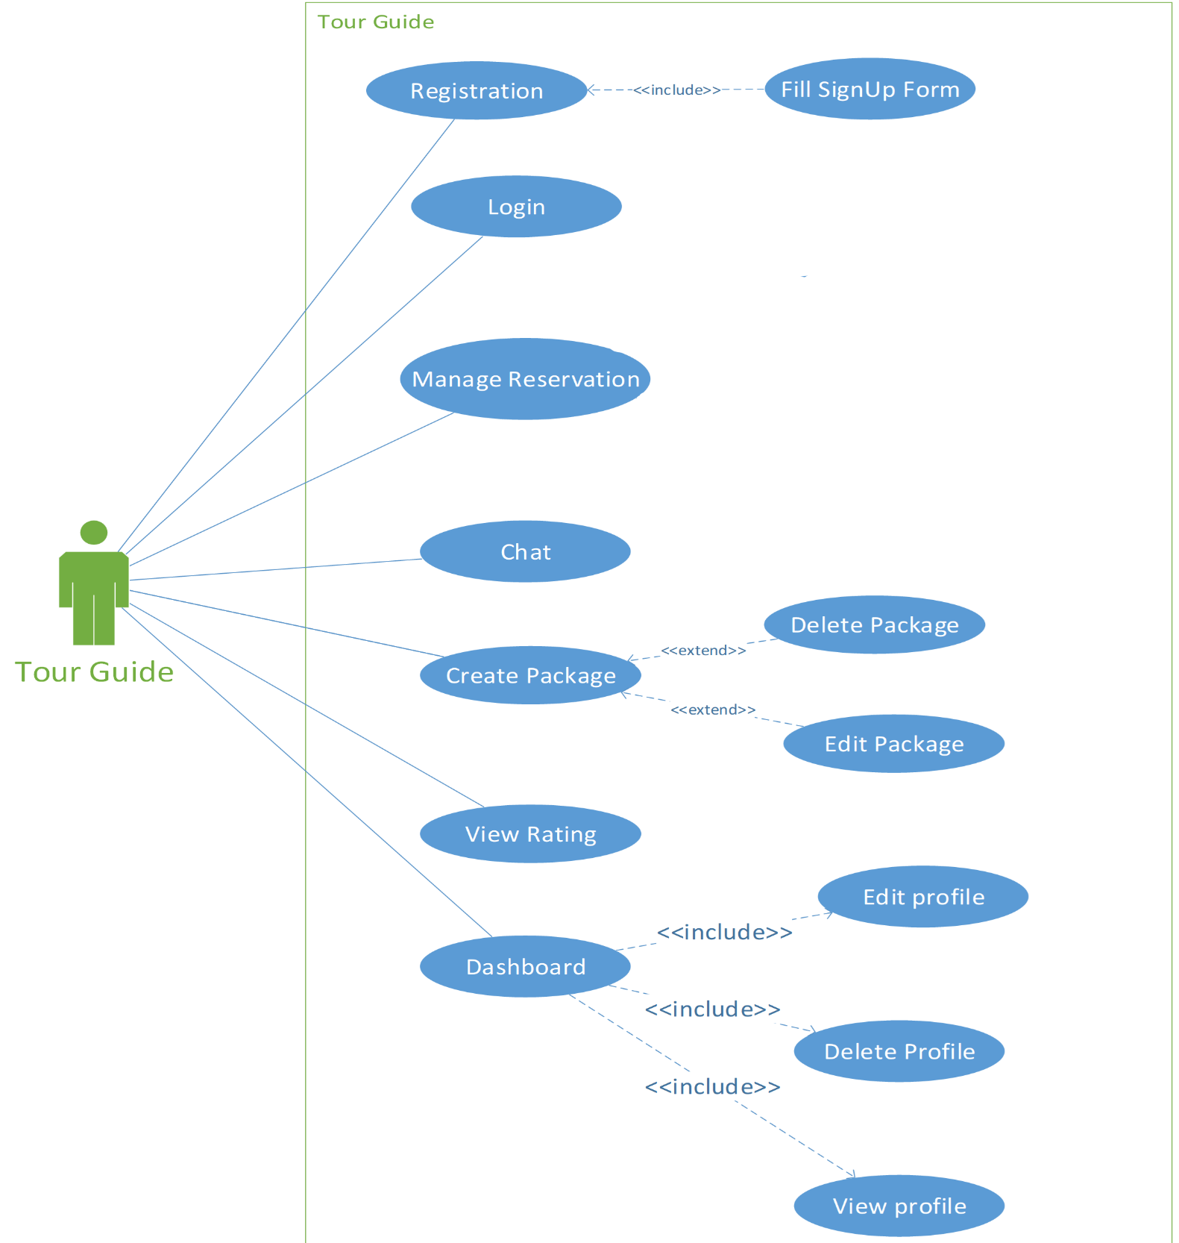
Tour Guide Usecases

Slide 12
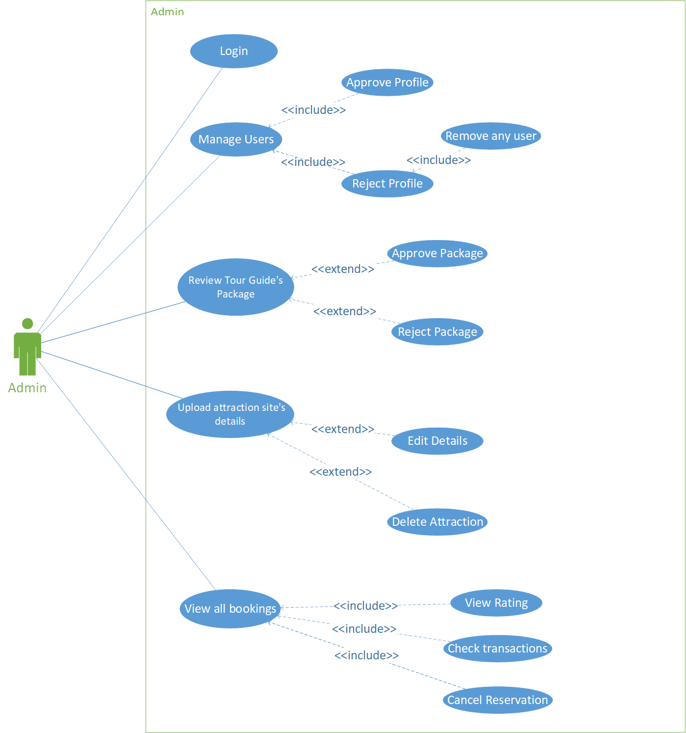
Admin Usecases

Slide 13
Screenshots

Slide 14
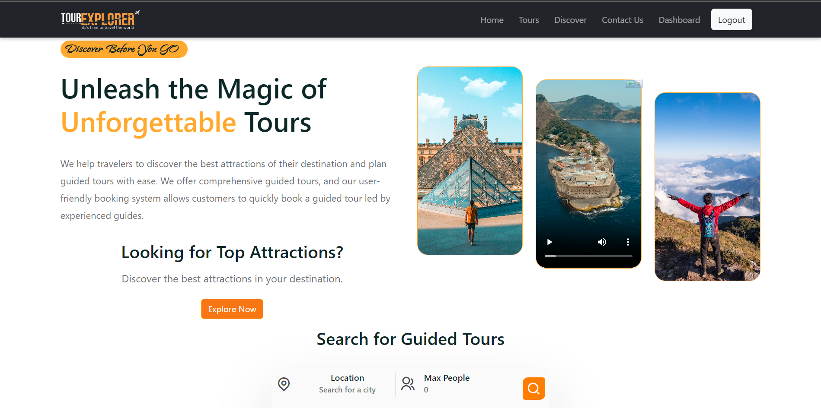

Slide 15
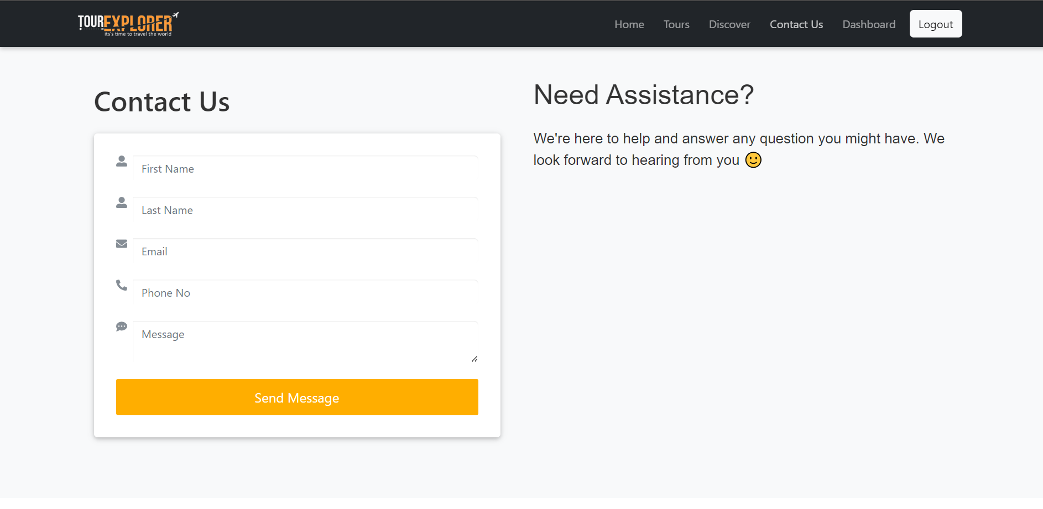

Slide 16
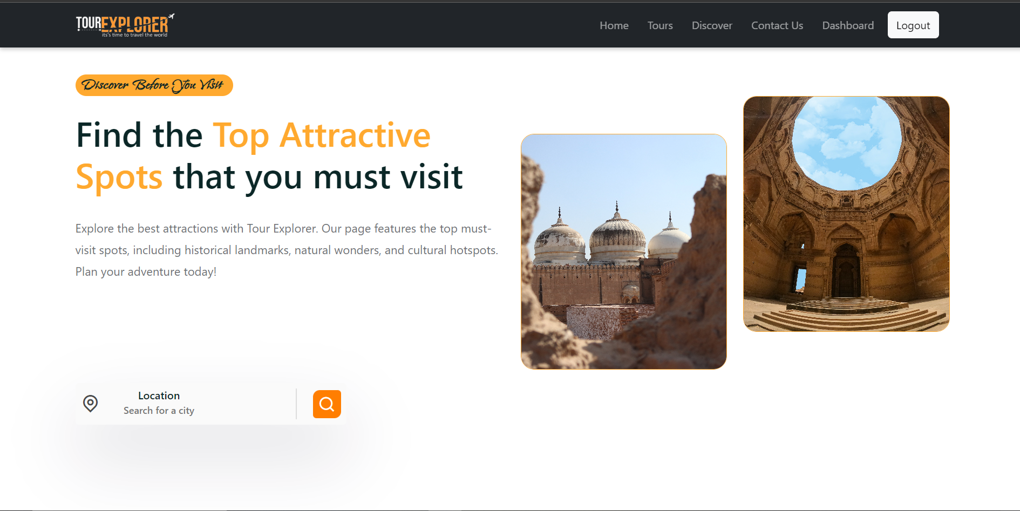

Slide 17
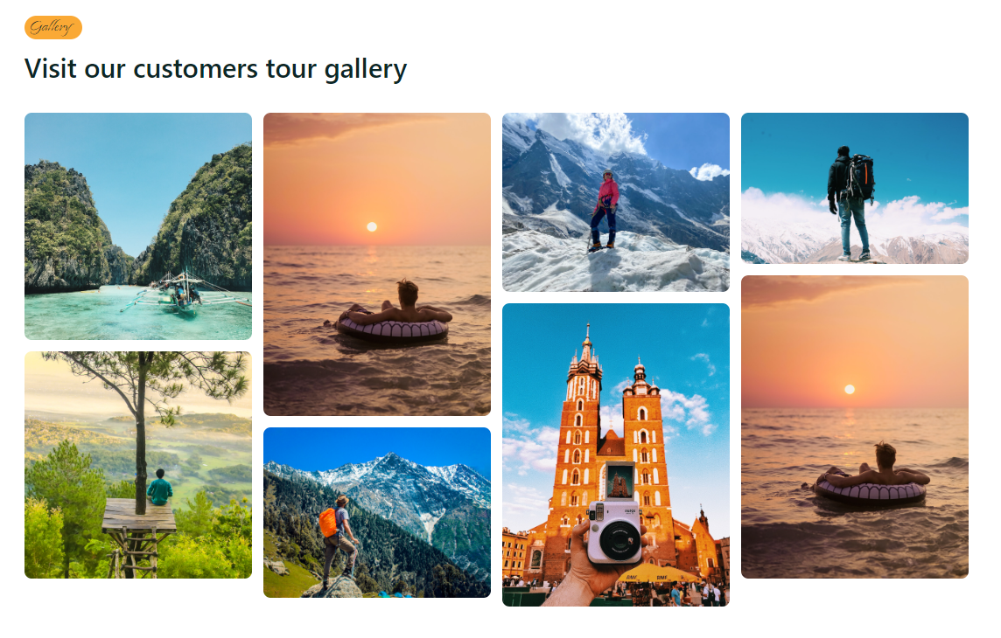

Slide 18
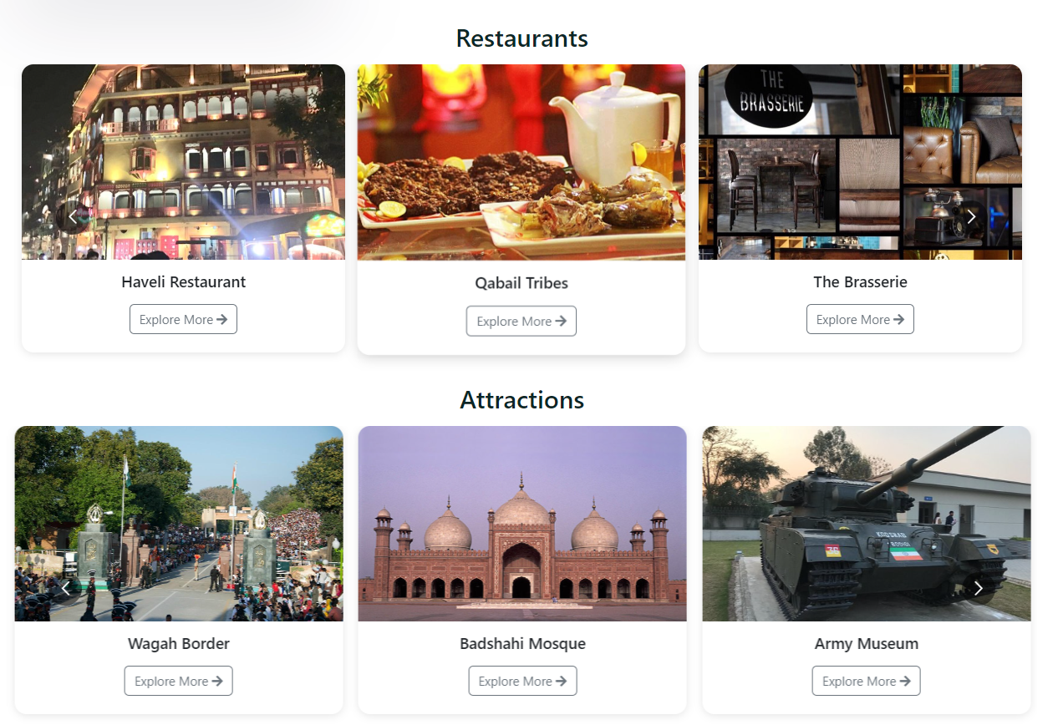

Slide 19
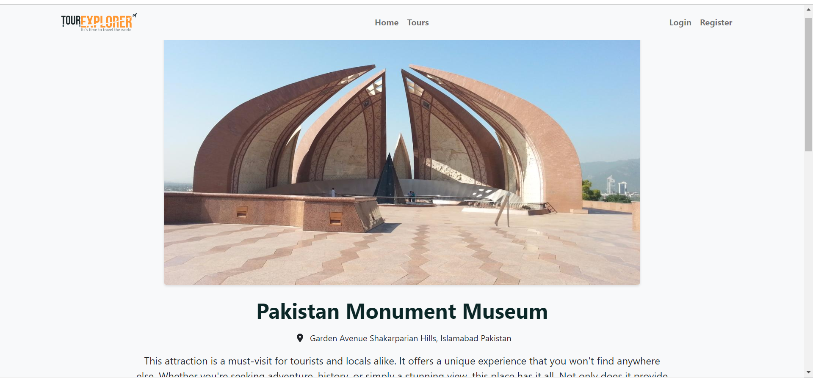

Slide 20
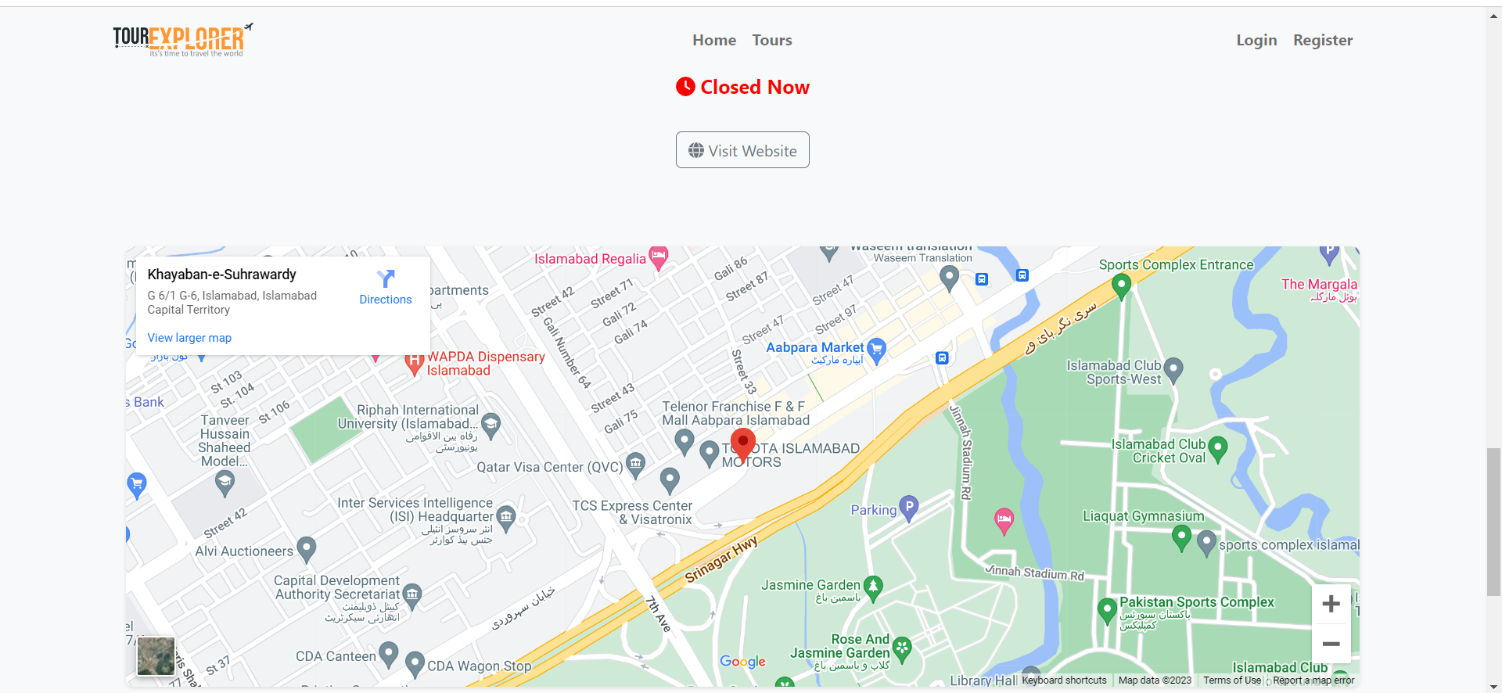

Slide 21
Thank You

